Slide 1
APPLIED PHSICS
(SEAP-113)

Slide 2
Quiz Rules
Only write short answer (in few words). Don’t go in details.
Any communication with others during the quiz will result in a zero score.
Time Limit is 10 mins.

Slide 3
Sample Quiz Question
Question: In an AC circuit, the direction of current?
Question: Which type of current periodically changes direction?
Question: Which of the following is a measure of opposition to the flow of electric current?
Question: Voltage is also known as:
Question: Electric field is defined as the:
Question: What is the fundamental unit of electric charge?

Slide 4
Quiz No. 1
Question 1: What happens to the electric field between two opposite charges as the distance between them increases?
Question 2: What is the relationship between voltage, current, and resistance in a circuit, according to Ohm's Law?
Question 3: In a series circuit, how does the total resistance compare to the individual resistances?
Question 4: Direction of Conventional current flows?
Question 5: The SI unit for electric current is?

Slide 5
Quiz (Contd.)
Question 6: In an AC circuit, what does the frequency of the alternating current represent?
Question 7: If there is no net transport of charge in conductor, the electric current will be?
Question 8: If you double the voltage in a circuit, what happens to the current (assuming resistance remains constant)?
Question 9: What happens to the resistance of a conductor when its temperature increases?
Question 10: Resistance of a piece of material depends on?

Slide 6
Introduction of Materials

Slide 7
Introduction of Materials
Every material in nature has certain properties. These properties define the behavior of the materials. Material Science is a branch of electronics that deals with the study of flow of electrons in various materials or spaces, when they are subjected to various conditions.
Due to the intermixing of atoms in solids, instead of single energy levels, there will be bands of energy levels formed. These set of energy levels, which are closely packed are called as Energy bands.

Slide 8
Types of Materials
The energy band in which valence electrons are present is called Valence band, while the band in which conduction electrons are present is called Conduction band. The energy gap between these two bands is called as Forbidden energy gap.
Electronically, the materials are broadly classified as Insulators, Semiconductors, and Conductors.

Slide 9
Types of Material contd.
Insulators − Insulators are such materials in which the conduction cannot take place, due to the large forbidden gap. Examples: Wood, Rubber.
Semiconductors − Semiconductors are such materials in which the forbidden energy gap is small and the conduction takes place if some external energy is applied. Examples: Silicon, Germanium.
Conductors − Conductors are such materials in which the forbidden energy gap disappears as the valence band and conduction band become very close that they overlap. Examples: Copper, Aluminum.

Slide 10
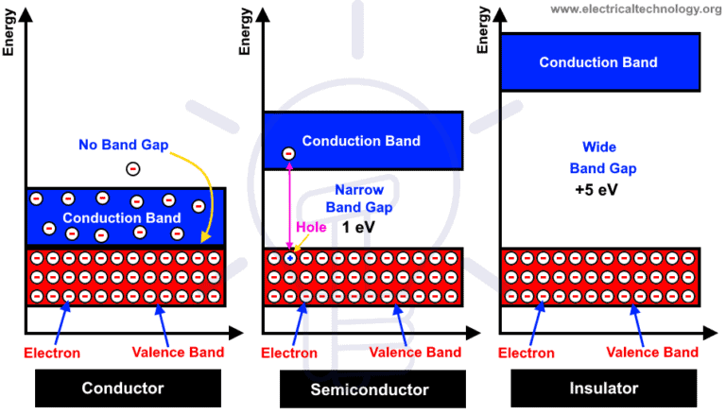
Valence & Conduction Band

Slide 11
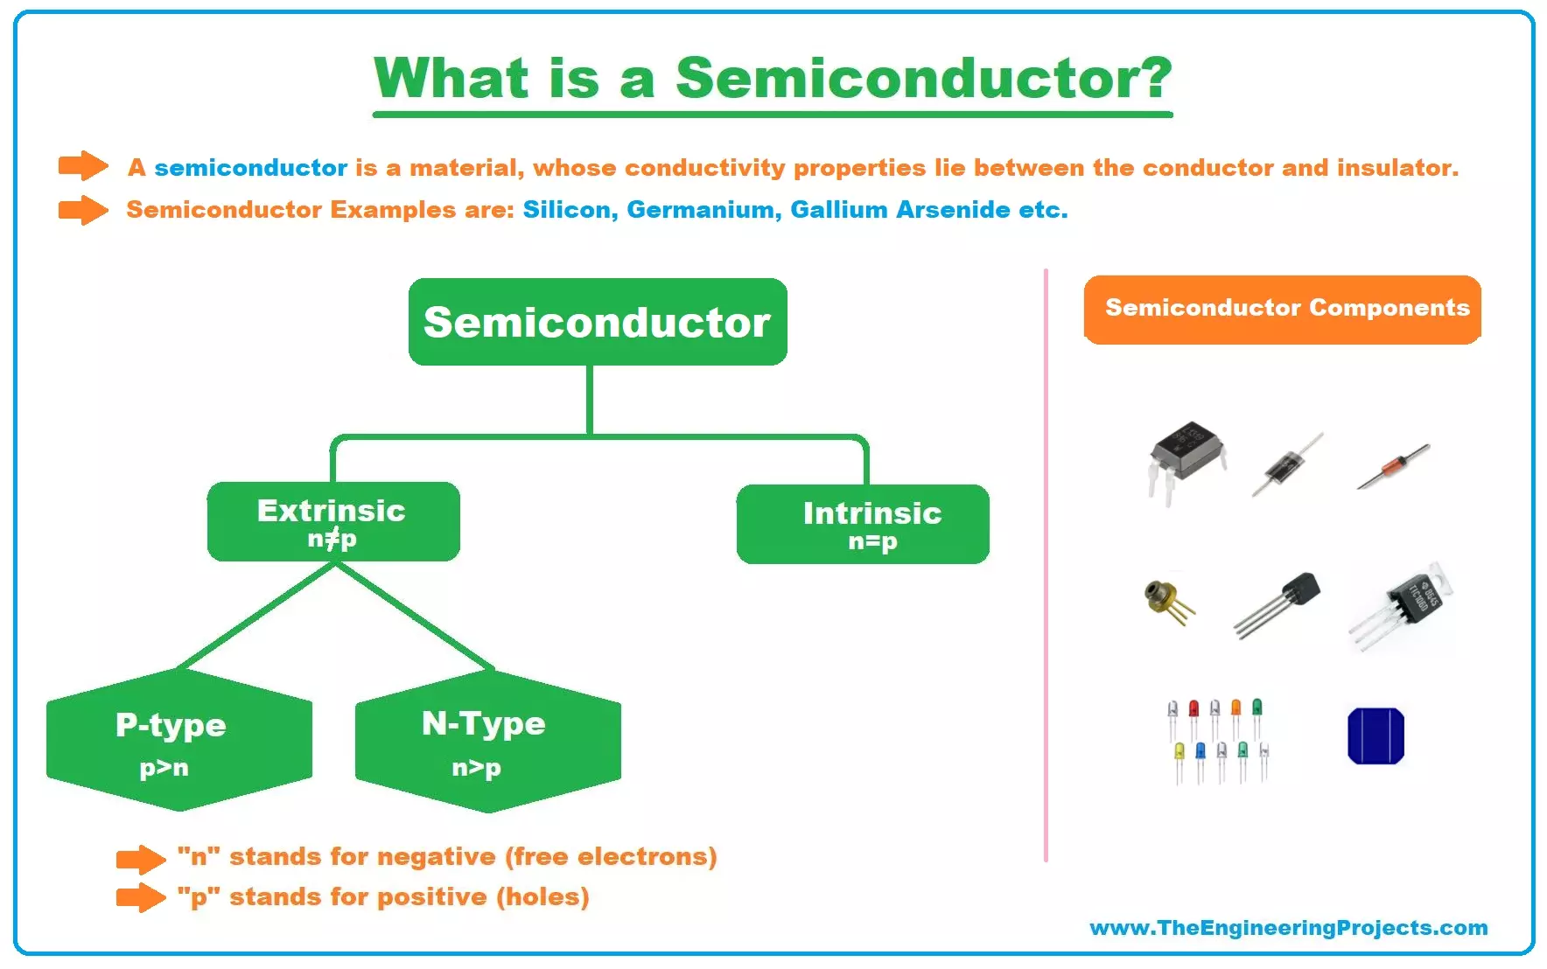
What is Semiconductor?

Slide 12
Why Semiconductor?
Of all the three, insulators are used where resistivity to electricity is desired and conductors are used where the conduction has to be high.
The semiconductors are the ones which give rise to a specific interest of how they are used.
We need to have strong control over the conductivity of material.
By controlling conductivity we can actually turn on and turn off the device which is very much required in digital circuits.
Semiconductors are employed in the manufacture of various kinds of electronic devices, including diodes, transistors, and integrated circuits.
Such devices have found wide application because of their compactness, reliability, power efficiency, and low cost.
Due to their role in the fabrication of electronic devices, semiconductors are an important part of our lives. Imagine life without electronic devices. There would be no smartphones, radios, TVs, computers, video games, or advanced medical diagnostic equipment.

Slide 13
Semiconductors
What is conductor ?
Copper (29 e-) is a good conductor as it has only one electron is its valence band
Similarly the materials which has 4 electrons in their valence band are semiconductor materials
Examples are Si (14 e-), Germanium (32 e-), Carbon (4 e-) etc.

Slide 14
Semiconductors (contd.)
Why silicon is widely used as compared to germanium?
Reason is the atomic structure of both materials
Silicon has 4 electrons in its 3rd shell while Germanium also has 4 electrons but in 4th shell
Germanium valence e- require small energy to escape from the atom
This makes Germanium unstable at high temperatures
That’s why Silicon is most widely used in electronics

Slide 15
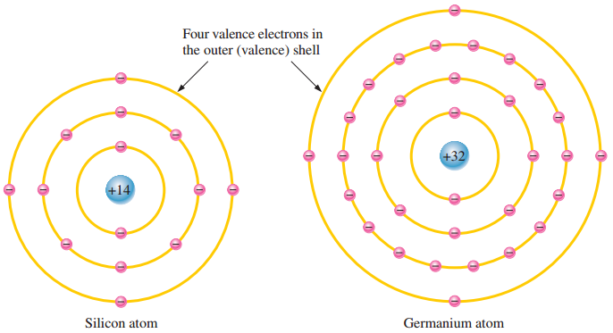
Atomic Structure of Silicon & Germanium

Slide 16
Doping of Semiconductors
The process of adding an impurity atoms into the semiconductor to increase its ability to conduct electricity is known as doping and the impure semiconductor is known as a doped semiconductor.
Doping is done to modify the electrical conductivity, carrier concentration, and other electrical characteristics of the semiconductor.
Types of Doping: There are two main types of doping:
N-type doping: Introduces donor impurities that provide extra electrons (e.g., phosphorus, arsenic).
P-type doping: Introduces acceptor impurities that create holes (missing electrons) (e.g., boron, gallium).
Dopant Atoms and Crystal Lattice: Dopant atoms replace some of the atoms in the crystal lattice of the semiconductor.
Creation of Charge Carriers:
N-type doping creates excess negative charge carriers (electrons).
P-type doping creates excess positive charge carriers (holes).

Slide 17
Types of Semiconductors
Intrinsic Semiconductor
An intrinsic (pure) semiconductor, also called an undoped semiconductor or i-type semiconductor, is a pure semiconductor without any significant dopant species present. The number of charge carriers is therefore determined by the properties of the material itself instead of the amount of impurities.
Extrinsic Semiconductor
An extrinsic semiconductor is a semiconductor doped by a specific impurity which is able to deeply modify its electrical properties, making it suitable for electronic applications (diodes, transistors, etc.) or optoelectronic applications (light emitters and detectors).
Two Types of Extrinsic Semiconductor
P-type Semiconductor
N-type Semiconductor

Slide 18
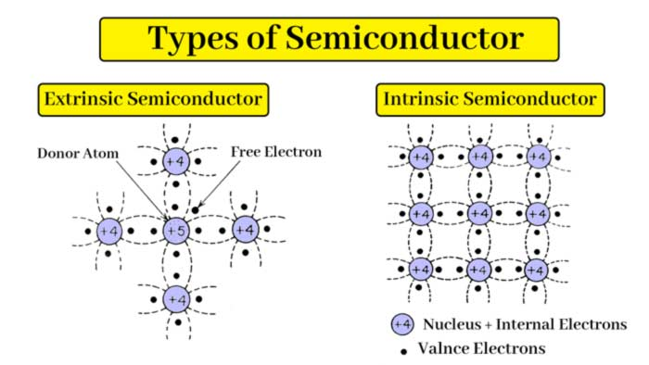
Types of Semiconductor

Slide 19
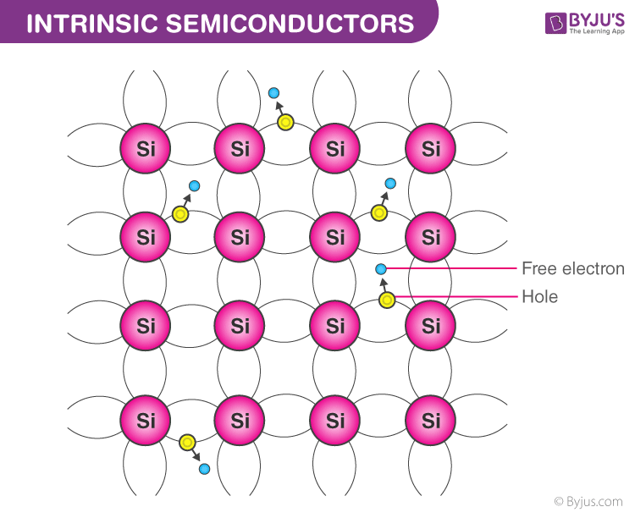
Intrinsic Semiconductor Atomic Structure

Slide 20
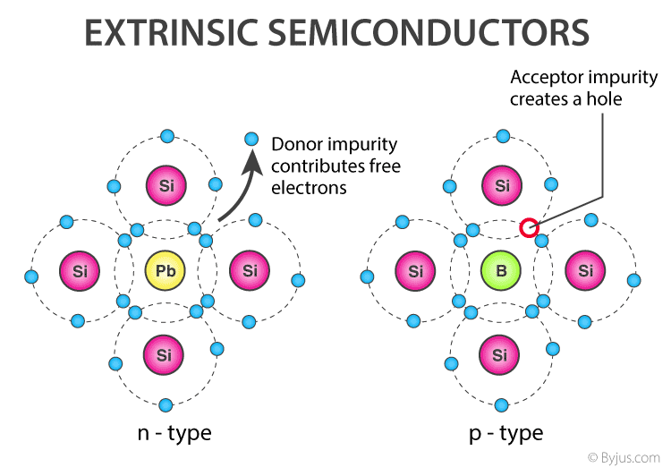
Extrinsic Semiconductor Atomic Structure

Slide 21
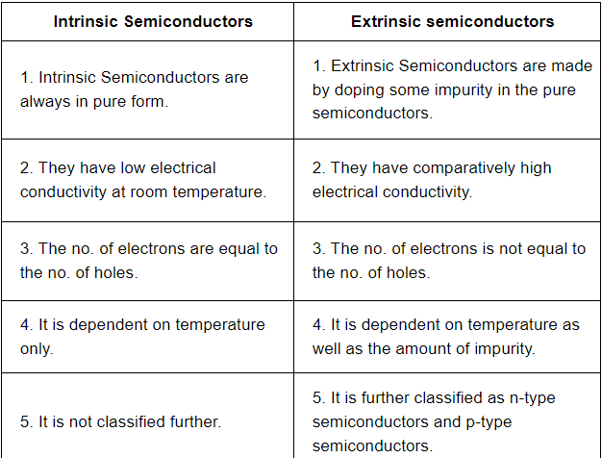

Difference between Intrinsic & Extrinsic Semiconductors

Slide 22
Why do we not use intrinsic semiconductor?
There are mainly three reasons:
Conductivity is low due to small number of charge carriers.
Number of free electron depends upon temperature, we can't control it.
Number of electrons are always equal to number of holes. Therefore, the current have a fixed ratio which we can not change.

Slide 23
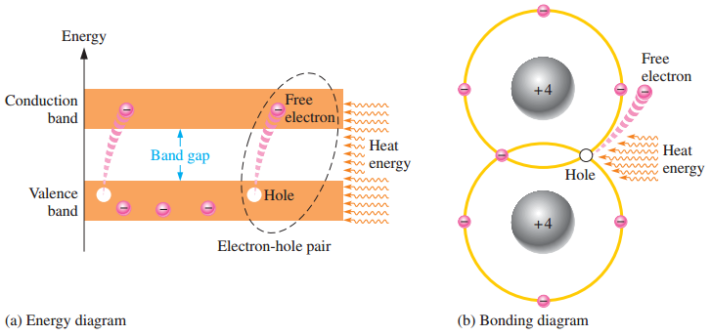
Semiconductors (contd.)
Concept of Hole
At room temp, some valence electrons
absorbs energy and jump to the
conduction band
This causes a vacancy in the valence
band of crystal called hole
Recombination is the process when an e- falls in the hole

Slide 24
Semiconductors (contd.)
Concept of Free Electrons
Free electron, unlike bound electrons within atoms, there is no specific atom or nucleus to which the electron is attached; it is not bound to any particular atomic nucleus and is free to move within the material.
These electrons move freely and conduct electricity.

Slide 25
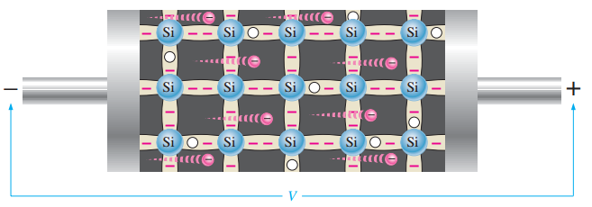
Semiconductors (contd.)
When voltage is applied to pure semiconductor, then e- can easily move towards positive side
Known as electron current

Slide 26
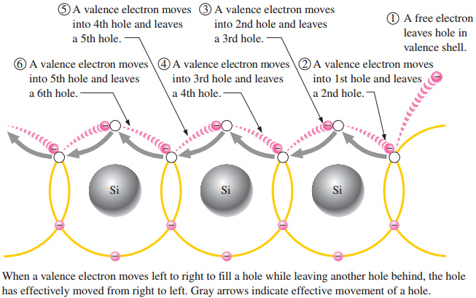
Semiconductors (contd.)
Other type is hole current, which is explained well in diagram

Slide 27
N-type Semiconductor
n-type semiconductor: in which pentavalent materials added by doping to achieve certain electrical characteristics.
Doped materials can be: Arsenic, Phosphorous, Bismuth and Antimony and called donner atoms
Majority Charge Carriers are Free Electrons.
Minority Charge Carries are Holes

Slide 28
P-type Semiconductor
p-type semiconductor: in which trivalent materials added by doping to achieve certain electrical characteristics
Doped materials can be: Boron, Indium and Gallium and called acceptor atoms
Majority Charge Carriers are Holes.
Minority Charge Carries are Free Electrons

Slide 29
Why N-Type and P-Type are electrically neutral?
N-type and P-type semiconductors are electrically neutral because the dopant atoms are itself neutral and they are introduced in the neutral semiconductor material. So, after the doping process, the whole material is electrically neutral.
In N-type, extra electrons from donor impurities create negative charges, but the semiconductor crystal's positively charged nuclei balance these out, maintaining neutrality.
Similarly, in P-type, acceptor impurities create positive "holes," but the negative charge of the remaining electrons in the crystal neutralizes this positive charge, resulting in an overall electrically neutral material.

Slide 30
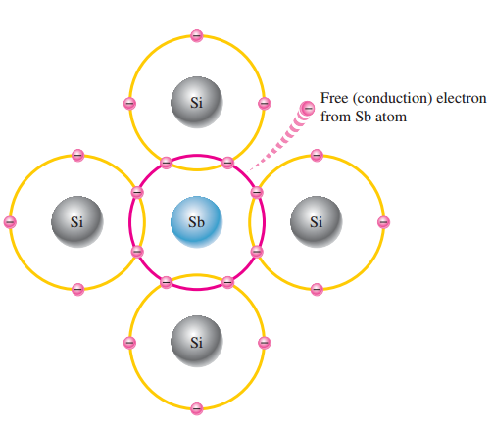
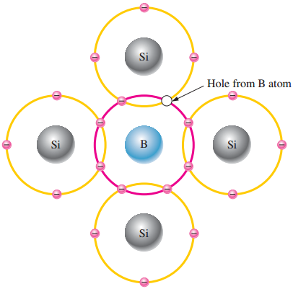
Semiconductors (contd.)

Slide 31
Diode

Slide 32
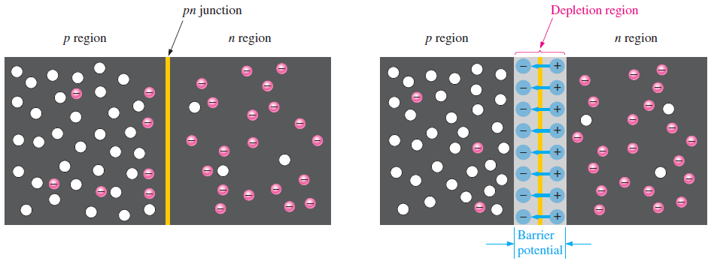
Diode Theory
Intrinsic semiconductor doped with trivalent and pentavalent material, a boundary called pn-junction is formed between the p-type and n-type material
This pn-junction is called diode.

Slide 33
Diode Theory (contd.)
For every electron which diffuse at the boundary, a positive charge is left in the n-region and a negative charge is left in the p-region
This is barrier potential of diode which forbids further diffusion
The region where this electron hole recombination occurs is called depletion region
Certain amount of voltage equal to barrier potential is required to flow the electrons across the junction
Typical barrier potential for Silicon diode is 0.7V and for Germanium 0.3V at 25°C

Slide 34
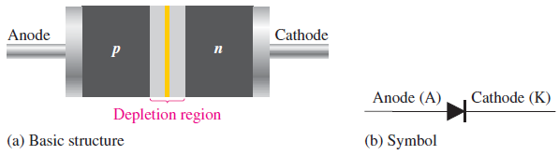
Diode Theory (contd.)
Typical diode structure and symbol is shown in fig
p-type region is called Anode and n-type region is called Cathode
pn-junction is in between the Anode and Cathode

Slide 35
Biasing of Diode

Slide 36
Biasing of Diode
In electronics, 'biasing' usually refers to a fixed DC voltage or current applied to a terminal of an electronic component such as a diode, in order to establish proper operating conditions for the component.
It is a crucial aspect of designing electronic circuits, especially in semiconductors like diodes, transistors.
Proper biasing ensures that the device operates in a stable and predictable manner.
Biasing a diode in electronics refers to the process of applying a specific voltage (or current) to the diode in order to control its electrical behavior and allow it to function in a desired way.
Two main types of diode biasing:
Forward Bias
Reverse Bias.

Slide 37
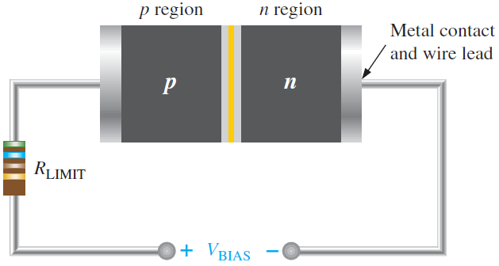
Forward Biasing
Biasing of diode is when it is connected with a voltage source
When n-type material is connected with -ive and p-type material is connected with +ive side of source, it is called forward biasing
V_{bias} should be greater than the barrier potential

Slide 38
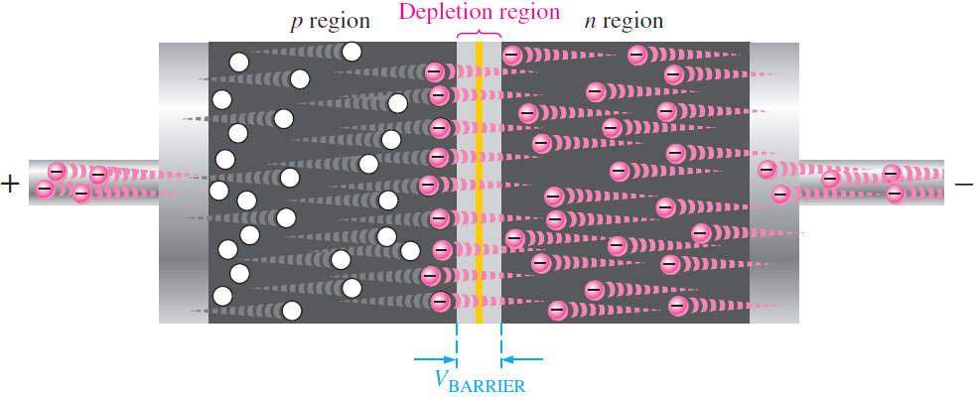
Forward Biasing (contd.)
when voltage is greater then the barrier potential, free electrons crosses the barrier potential and move into the p-type material
Electron current induced inside the diode

Slide 39
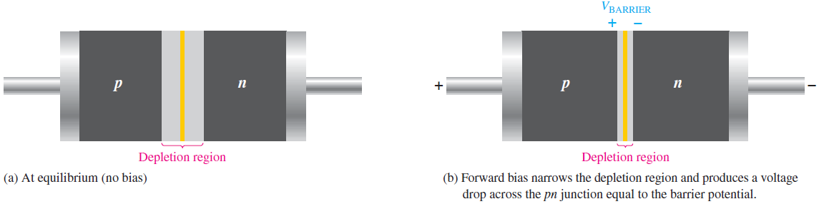
Forward Biasing (contd.)
More electron flow towards the depletion region, positive charge reduce and same is true for holes
This causes the depletion region to becomes narrow
Also the concept of energy hill

Slide 40
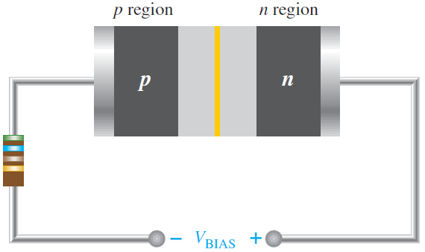
Reverse Biasing
Reverse biasing is the condition prevents the flow of current through diode.
When p-type is connected with -ive and n-type is connected with +ive end of source.

Slide 41
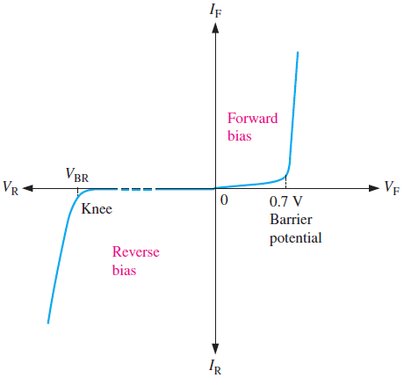
IV Characteristic Curve

